Slide 1
Sadro et al 2012: “Patterns of increase with lake network number were found for dissolved organic carbon and nitrogen, fluorescence of DOM, alkalin- ity, and bacterioplankton abundance, whereas nitrate and nitrogen to phosphorus nutrient ratios decreased.”
-but this is just one paper, so should look into others
-note on bacterioplankton: their chl a values ranges from 0.3-2.7ug/L so this was not a productive system
So, as you go along a reservoir continuum (BVR-> FCR) we might expect to see:
DOC, TN, DOM, bacterioplankton +
N:P, Nitrate, chla -
Goodman et al 2011, Xu & Xu 2018: lakes act differentially as sinks (during high flow) and as sources (low flow) of DOM (C, N, & P)
Hypothesis: BVR will act as a sink for DOM immediately after storm events (i.e., DOM will be lower at BVR outflow than at site 50) and a source for DOM during dry periods (i.e., BVR will export DOM)

Slide 2
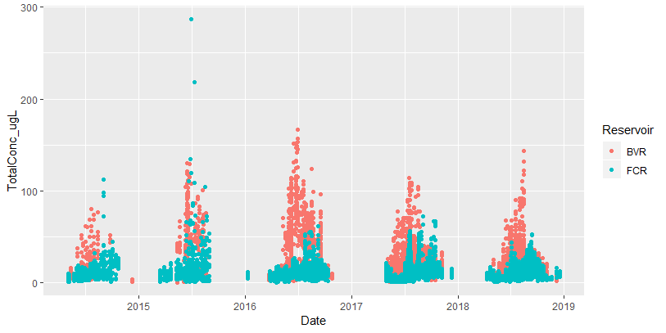
Total Chlorophyll
Sadro(NS) -
BVR-> FCR -
-Fluoroprobe chl data
-all depths of chl included here
-overall, BVR has more phytos than FCR (over all depths**)
-trend of BVR bloom developing earlier, followed by FCR spikes in chl????
-if most nutrients to FCR are coming from BVR, this makes sense? Or is it the opposite that once phyto population is established, fewer nutrients should be getting downstream?
NOTE: probably should correct for area to see if overall concentration is different per unit area

Slide 3
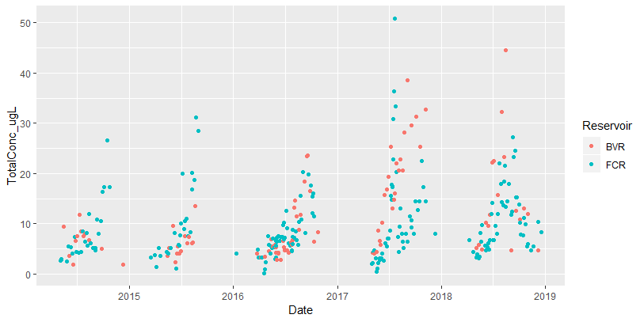
Chlorophyll at 1 m
Sadro (NS) -
BVR-> FCR +
-fluoroprobe chl data at 1m
-not a strong signal, varies from year to year which is higher, overall looks like FCR is higher

Slide 4
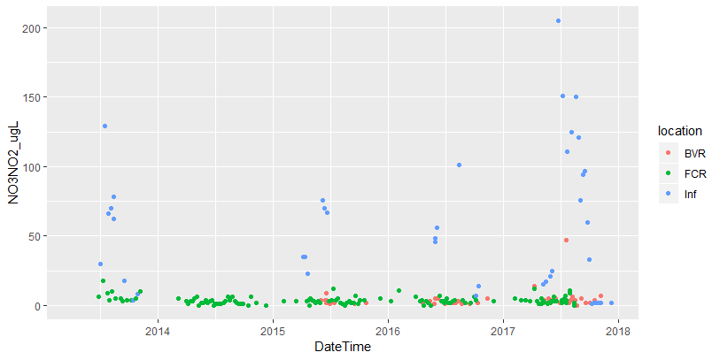
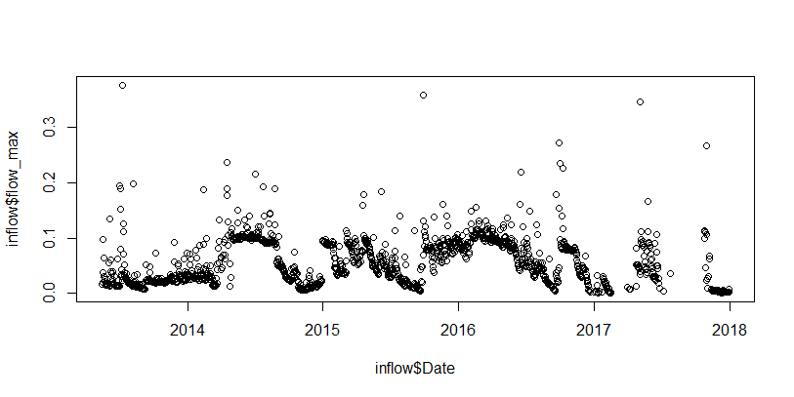
-big spikes in inflow nitrate-ite following max discharge events
-would (WILL!) be super cool to see what the inflow to BVR looks like during big storm events!!!

Slide 5
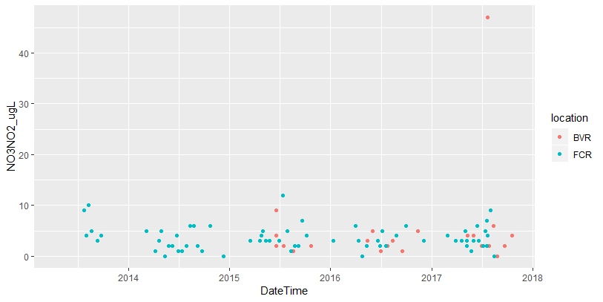
Looking nitrate-ite for just BVR and FCR to see dynamics at smaller conc.
-[diss nitrogen] increases through reservoir continuum??, possibly because of the stream input from inflow???
Sadro –
BVR-> FCR +

Slide 6
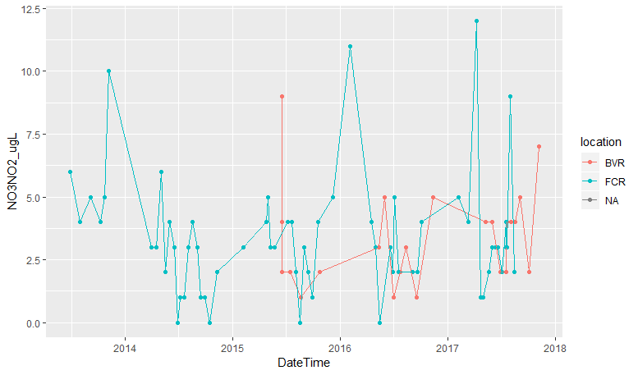

Slide 7
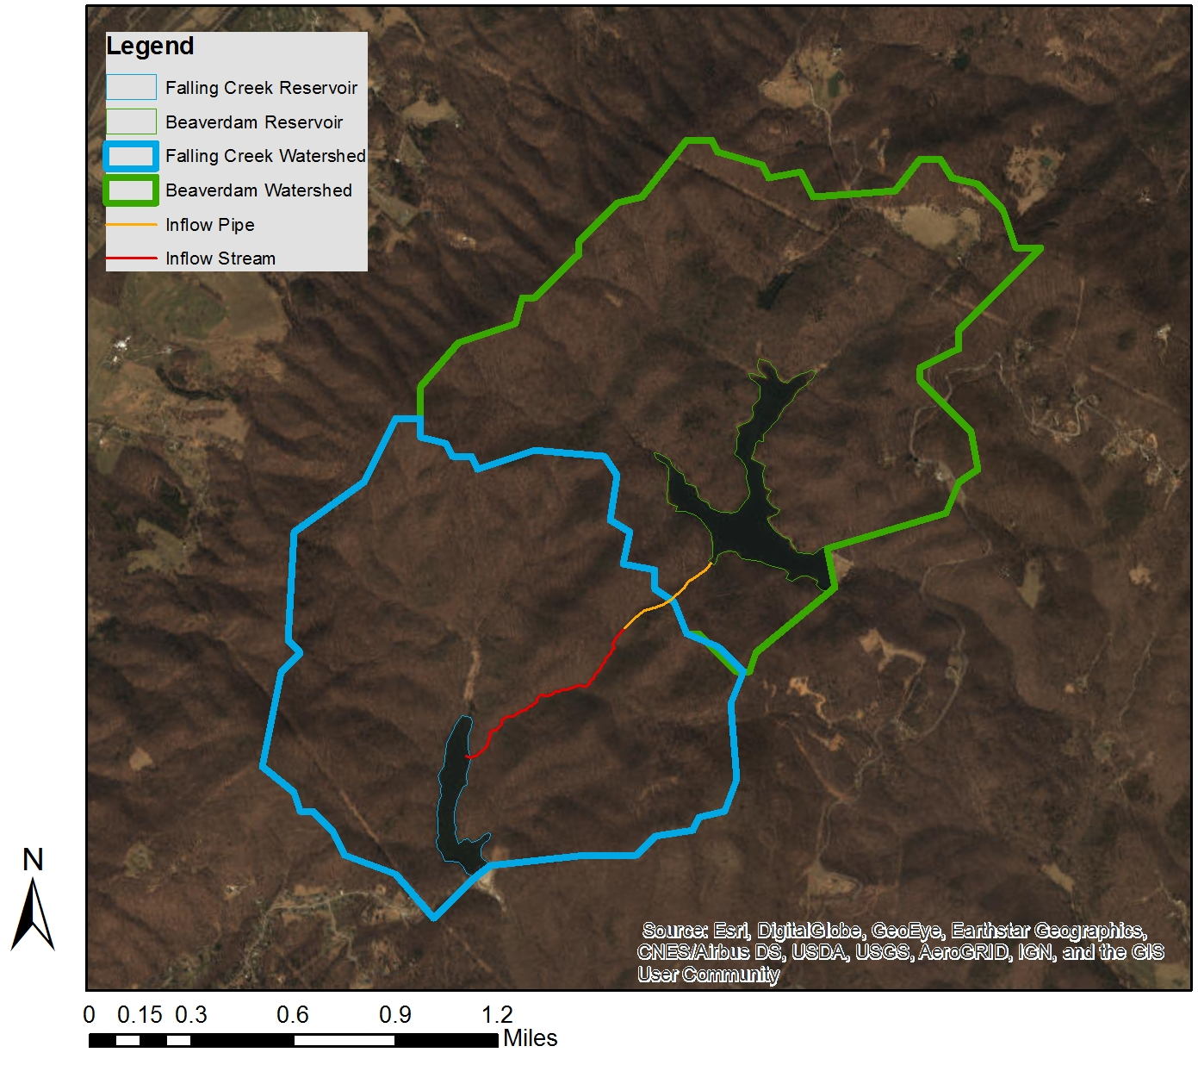

Slide 8
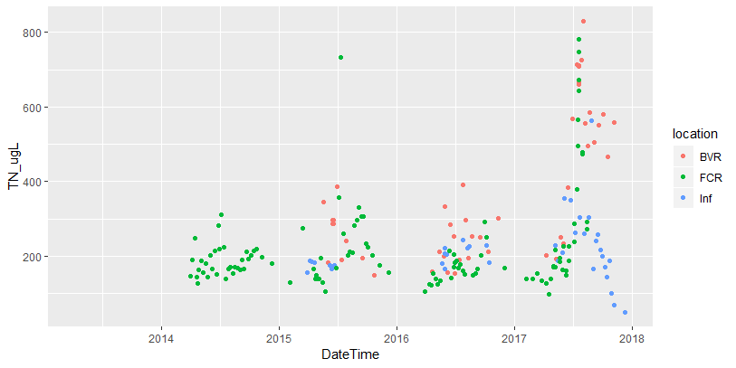
Sadro +
BVR->FCR + (?)
Total nitrogen shows a different (less clear) signal than dissolved nitrogen
SO, from this preliminary look, FCR has slightly higher nitrogen concentrations than BVR
Relatively low TN at Inf immediately after high values in BVR and FCR is interesting

Slide 10
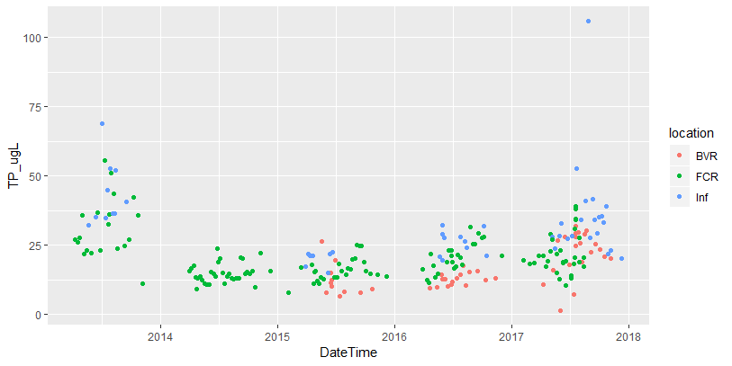
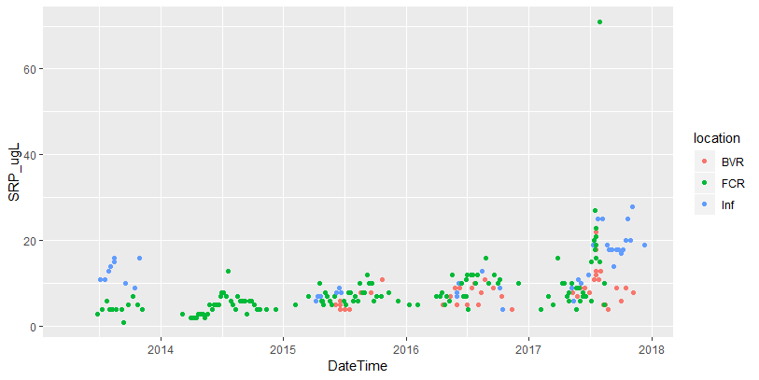
-[phosphorus] increases through reservoir continuum?
-inflow has a different response than FCR and BVR—different mechanisms in streams?

Slide 11
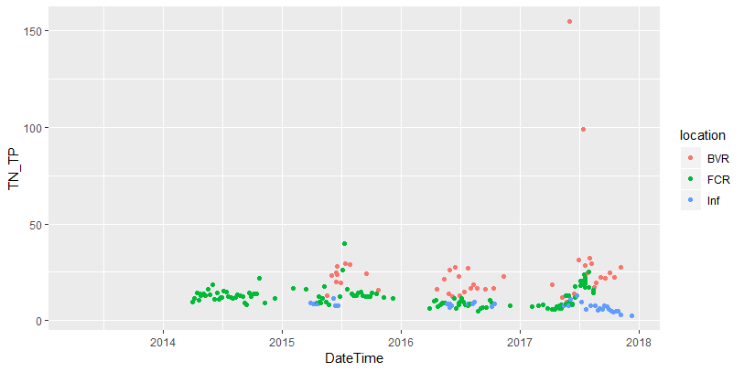
-BVR is consistently higher
-BVR P-limited??
-TP and SRP also show less P in BVR
-this aligns with findings from Sadro et al 2012

Slide 12
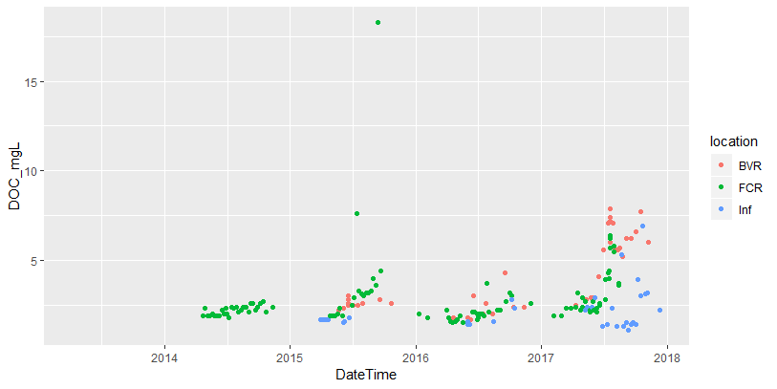
Only clear signal I see is that inflow is always lower (which makes sense because of area + productivity)

